Slide 1

Exploring Technology Trends Through Data Visualization
Sweta Patel
July 2025

Slide 2


OUTLINE
Executive Summary
Introduction
Methodology
Results
Visualization – Charts
Dashboard
Discussion
Findings & Implications
Conclusion
Appendix

Slide 3
EXECUTIVE SUMMARY
In an era of rapidly evolving digital technologies, organizations must understand the tools and platforms that technology professionals currently use—and aspire to use—in order to remain competitive and innovative. This project analyzes global developer survey data to uncover trends in programming languages, databases, platforms, and web frameworks, alongside demographic insights such as age, education, and geographic distribution.
By identifying both current usage patterns and future preferences, this analysis supports strategic decision-making in areas such as technology adoption, workforce development, recruitment planning, and market alignment. The findings enable businesses, educational institutions, and policy-makers to make data-driven decisions aligned with the evolving needs of the global tech workforce.

Slide 4

INTRODUCTION
Technology is advancing at an unprecedented rate, and so are the skills, tools, and preferences of professionals working in the field. For organizations building products, hiring talent, or designing education and training programs, understanding what technologies are in use—and which ones are gaining popularity—is critical.
This project is based on an extensive dataset of global survey responses from professionals in the technology sector. It explores key areas including:
Current technology usage (e.g., programming languages, databases, platforms, and frameworks)
Future technology interest (technologies professionals want to work with)
Demographic distribution (age, education level, and geographic location)
The ultimate objective is to generate actionable insights that can guide strategic planning and investments in technology and talent.

Slide 5
METHODOLOGY
To achieve the project goals, a structured data analysis process was followed:
Data Source The dataset survey_data_updated.csv was used, containing self-reported data from technology professionals worldwide.
Data Preparation
Cleaned and filtered the dataset to exclude nulls and irrelevant entries.
Transformed multi-response fields to analyze top technologies (e.g., “LanguagesWorkedWith”, “PlatformsWantToWorkWith”).
Categorization of Metrics The project focused on three key thematic areas:
Current Technology Usage: Measuring the top tools professionals currently use.
Future Technology Trends: Capturing aspirational tools and platforms respondents want to work with.
Demographic Insights: Understanding how age, education, and geography correlate with technology use.
Visualization Strategy Visualizations were created for each thematic area to simplify interpretation, highlight patterns, and communicate results clearly to non-technical stakeholders.

Slide 6

RESULTS

Slide 7
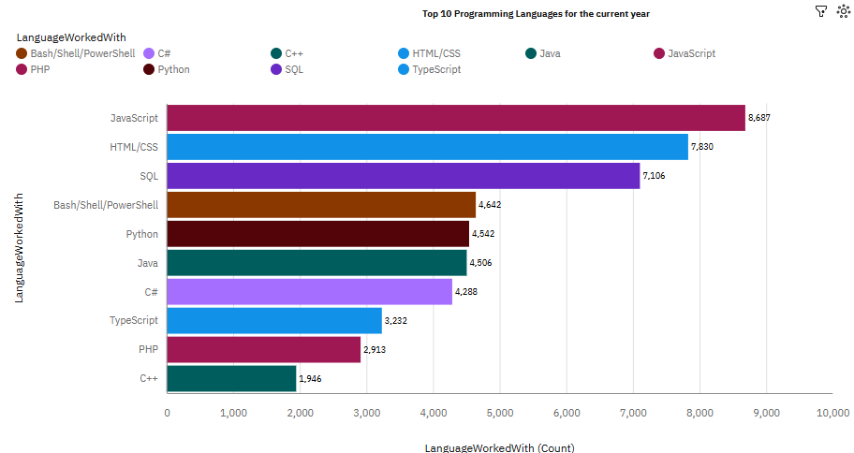
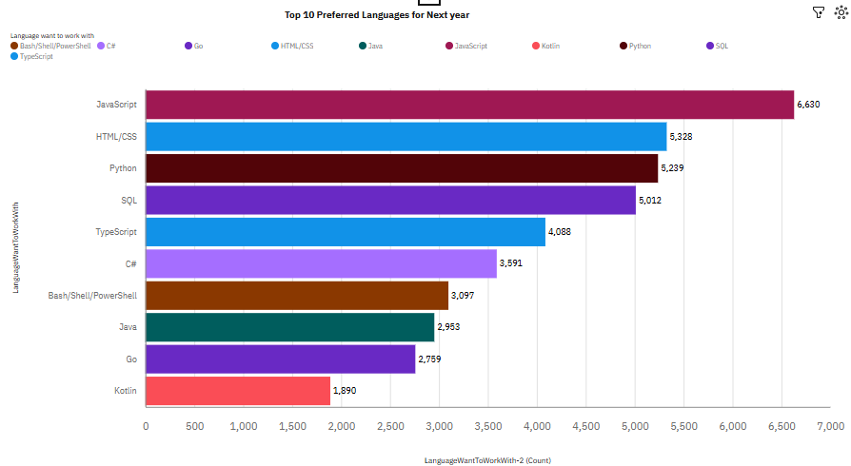
PROGRAMMING LANGUAGE TRENDS
Current Year
Next Year

Slide 8
PROGRAMMING LANGUAGE TRENDS - FINDINGS & IMPLICATIONS
Findings
Current Usage (Chart 1: "Top 10 Programming Languages for the Current Year")
JavaScript is the most used language (8,687).
HTML/CSS and SQL follow closely, indicating strong web and database usage.
Python, Java, and C# are used moderately (around 4,500–4,200 counts).
TypeScript, PHP, and C++ round out the bottom with lower usage.
Future Preference (Chart 2: "Top 10 Preferred Languages for Next Year")
JavaScript still leads (6,630), though slightly lower than its current usage.
Python increases in preference compared to current use.
TypeScript and Go are gaining popularity, entering top preferred ranks.
Kotlin appears in preferred list but not in current use top 10.
PHP and C++ drop out of the future preference chart.
Comparison & Trends
TypeScript and Go show growth trajectories.
PHP and C++ show declining popularity.
Bash/Shell/PowerShell and Java have slightly lower future preference than current usage.
SQL maintains strong presence in both charts.
Implications
Technology Adoption & Trends
Companies and developers may shift toward modern, high-productivity languages like Python, TypeScript, and Go.
JavaScript’s dominance will likely continue, especially for full-stack and frontend roles.
Education & Learning Focus
Learning Python, TypeScript, or Go could provide more future opportunities.
Older languages like PHP and C++ might receive less attention in modern curricula.
Hiring & Skill Planning
Recruiters may prioritize candidates skilled in JavaScript, Python, and TypeScript.
C++ and PHP roles may decline or become more specialized/legacy-focused.
Tooling & Ecosystem Investments
Increased future interest in Go and Kotlin could push tooling support and IDE improvements.
Companies maintaining systems in PHP or C++ may need migration strategies over time.
Community and Open Source Engagement
Communities and open-source projects around Python, TypeScript, and Go may grow faster.
SQL’s consistency signals ongoing demand in data-heavy roles.

Slide 9
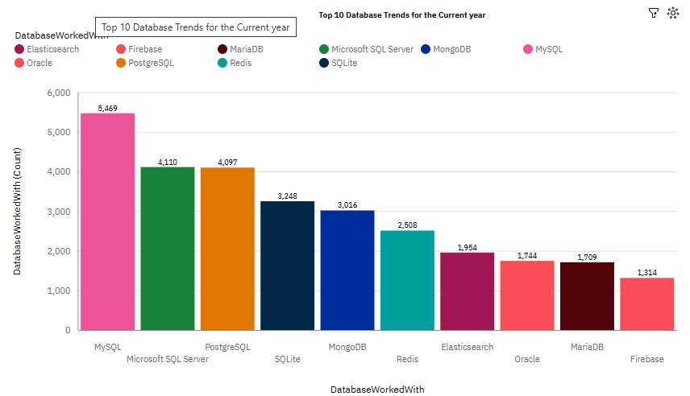
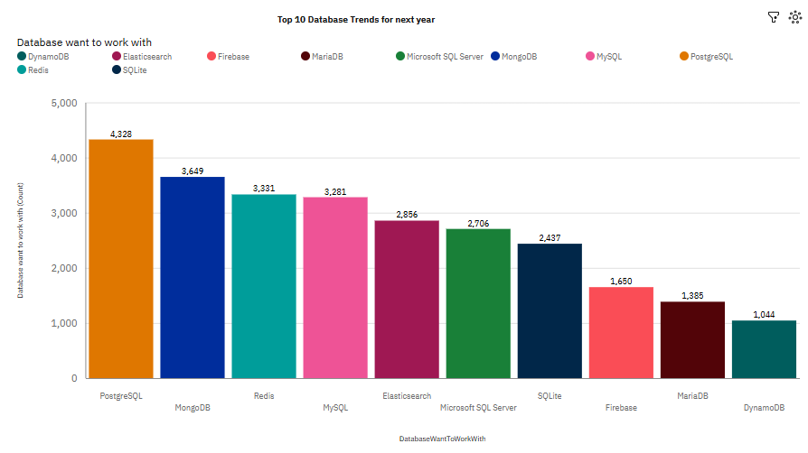
DATABASE TRENDS
Current Year
Next Year

Slide 10
DATABASE TRENDS - FINDINGS & IMPLICATIONS
Findings
Current Usage (Chart 1: "Top 10 Database Trends for the Current Year")
MySQL is the most widely used database with 5,469 users.
Microsoft SQL Server (4,110) and PostgreSQL (4,097) follow closely.
SQLite (3,248) and MongoDB (3,016) are moderately used.
Redis (2,508) and Elasticsearch (1,954) are also notable.
Oracle, MariaDB, and Firebase complete the list with lower usage (below 2,000).
Future Preference (Chart 2: "Top 10 Database Trends for Next Year")
PostgreSQL is the most preferred database for future use (4,328).
MongoDB (3,649) and Redis (3,331) follow with strong interest.
MySQL remains popular but drops to 3,281 in future preference.
Elasticsearch, Microsoft SQL Server, and SQLite maintain presence but with moderate interest.
Firebase, MariaDB, and DynamoDB are in the bottom three of future preferences.
Comparison & Shifts
PostgreSQL overtakes MySQL in preference, indicating rising popularity.
MongoDB and Redis show significant growth in future interest.
MySQL shows a decline in preference compared to current usage.
SQLite, Oracle, and MariaDB show lower interest for future use.
DynamoDB, not in the current top 10, enters the future preference chart, suggesting emerging interest.
Implications
Technology Direction & Developer Trends
Developers are increasingly favoring modern, flexible, and open-source databases like PostgreSQL, MongoDB, and Redis.
PostgreSQL’s rise reflects its growing appeal in both relational and JSON-based use cases.
Enterprise and Hiring Outlook
Organizations may need to upskill teams on PostgreSQL and MongoDB to match developer interest.
MySQL and Microsoft SQL Server, while still widely used, may see declining enthusiasm among developers.
Training & Education Planning
Courses and learning paths may shift focus toward PostgreSQL, MongoDB, Redis, and cloud-native databases like DynamoDB.
Decreased future interest in MariaDB, Oracle, and Firebase may deprioritize them in modern training programs.
Product and Ecosystem Support
Tech vendors and cloud providers might invest more in PostgreSQL-compatible services.
Redis’s growing popularity could drive development of caching and real-time data platforms.
SQLite, while still relevant, may be limited to embedded/local use cases due to decreasing interest.
Emerging Technologies
Entry of DynamoDB into the preferred list suggests a shift toward serverless and cloud-native architectures.
Elasticsearch holds steady, reflecting its niche in search and analytics systems.

Slide 11

DASHBOARD
Github link

Slide 12
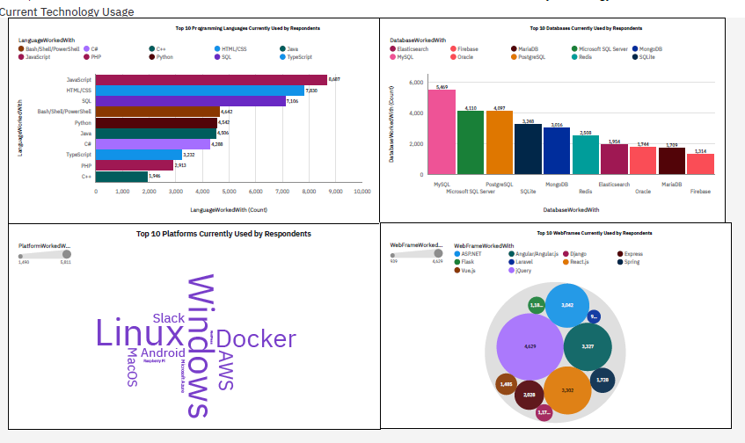
Current Technology Usage

Slide 13
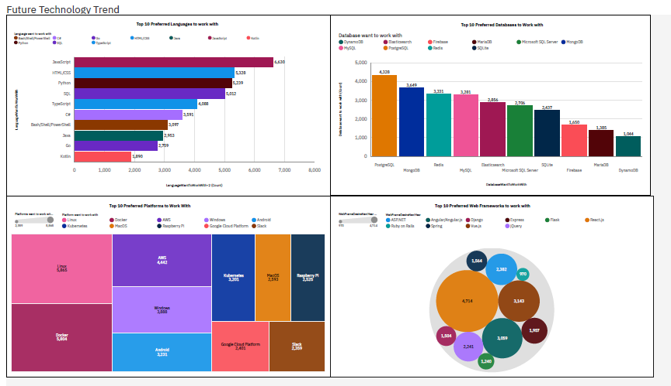
Future Technology Trend

Slide 14
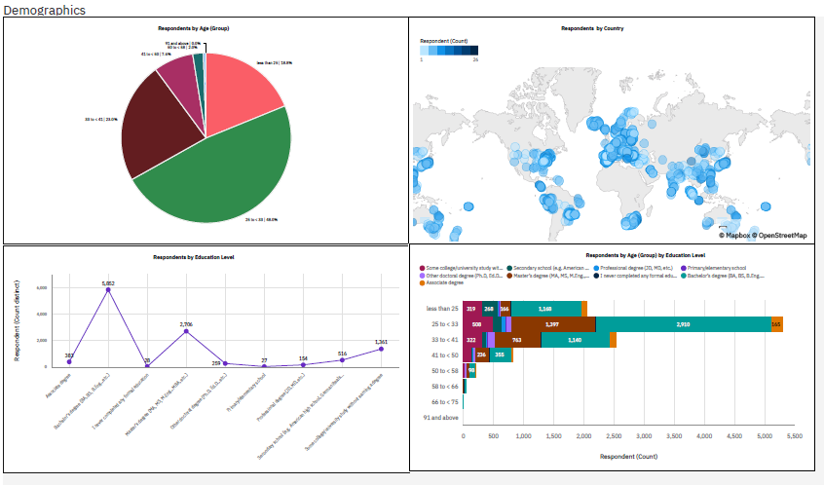
Demographics

Slide 15
DISCUSSION
Overall Findings and Implications

Slide 16
Overall Findings
Programming Languages
JavaScript is the most widely used and most preferred language.
Python is gaining popularity, moving up in preference compared to current use.
TypeScript and Go are on a growth trend, especially in future preference.
PHP and C++ show significant decline in interest.
SQL remains a stable and consistently used/query language.
Databases
MySQL is currently the most used, but PostgreSQL is the most preferred for future use.
MongoDB and Redis are gaining future interest significantly.
Firebase, MariaDB, and Oracle have low preference going forward.
DynamoDB emerges in future trends, though not heavily used currently.
Platforms
Linux, Windows, and Docker are the most used platforms.
Linux and Docker are also top preferred platforms for future use.
Kubernetes, Google Cloud Platform, and AWS show rising future demand.
Raspberry Pi and Android have moderate ongoing interest.
Web Frameworks
React.js leads in both usage and preference.
Django, Vue.js, and ASP.NET maintain moderate popularity.
Spring, Express, and Angular continue to see use but with less growth potential.
Flask and Ruby on Rails have less traction comparatively.
Demographics
Majority of respondents (68%) are aged 25–34.
Most respondents hold a Bachelor’s degree, followed by Master’s degrees.
Geographical distribution is global, with high density in North America, Europe, and South Asia.
Education levels skew heavily toward formal higher education, indicating a technically literate sample.

Slide 17
Overall Implications
Industry Readiness & Hiring
Companies should focus on hiring and training in JavaScript, Python, TypeScript, PostgreSQL, MongoDB, and React.js.
Declining interest in PHP, C++, Oracle, and MariaDB suggests these are mostly used for maintaining legacy systems.
Curriculum & Upskilling
Training programs should emphasize modern stacks (e.g., React + TypeScript + PostgreSQL + Docker + Linux).
Upskilling in cloud-native platforms (Kubernetes, AWS, Google Cloud) and data-centric tools (Redis, MongoDB) is critical.
Technology Investment & Tooling
Developers are gravitating toward open-source, cross-platform, and cloud-compatible technologies.
Tool and service providers should focus on enhancing support for PostgreSQL, Docker, React, and Linux environments.
Tech Trend Indicators
The rise in interest for Go, Kotlin, Redis, DynamoDB, and Kubernetes highlights where innovation and experimentation are heading.
PostgreSQL's overtaking of MySQL in future preference signals a shift toward more flexible and developer-friendly relational databases.
Demographic Focus
Given the dominance of the 25–34 age group with technical degrees, engagement strategies should be tailored for early-career to mid-career developers.
Geographic spread supports global community-building and localized training or events.

Slide 18
CONCLUSION
JavaScript remains dominant in both usage and preference, solidifying its role in web development.
Python and TypeScript are rapidly growing in popularity for data science and scalable applications.
PostgreSQL and MongoDB are becoming the top database choices, overtaking traditional systems like MySQL.
Linux and Docker lead as preferred platforms, showing strong adoption of open-source and containerization.
React.js is the top web framework, with wide current use and future demand.
Cloud-native tools like Kubernetes, AWS, and GCP are increasingly preferred, indicating DevOps growth.
Legacy tech (PHP, C++, Oracle) is in decline, mostly maintained for existing systems.
Developers value agility, favoring PostgreSQL, Redis, TypeScript, and Docker for performance and flexibility.
The developer base is young, educated, and global, primarily aged 25–34 with university degrees.
Emerging technologies like Go, Kotlin, DynamoDB, and Kubernetes are gaining developer attention and interest.

Slide 19
APPENDIX

Slide 20
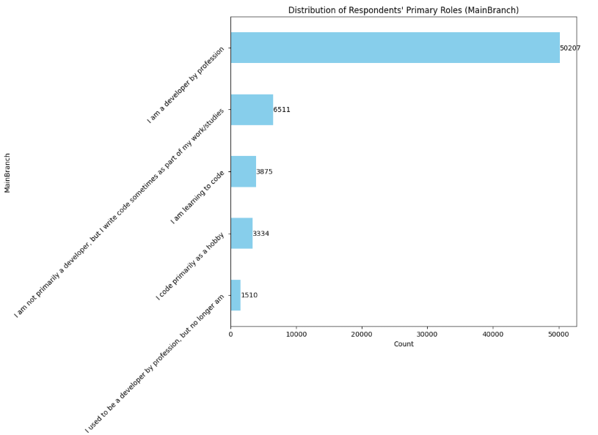
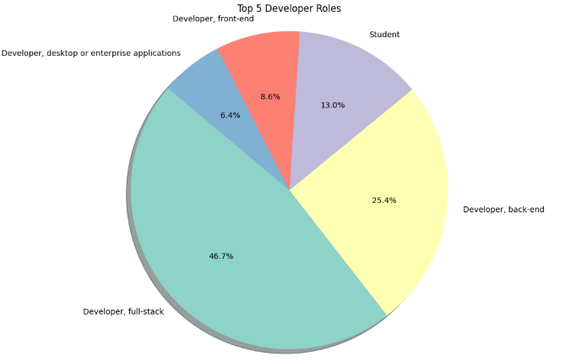
Appendix
Notes:
u

Slide 21
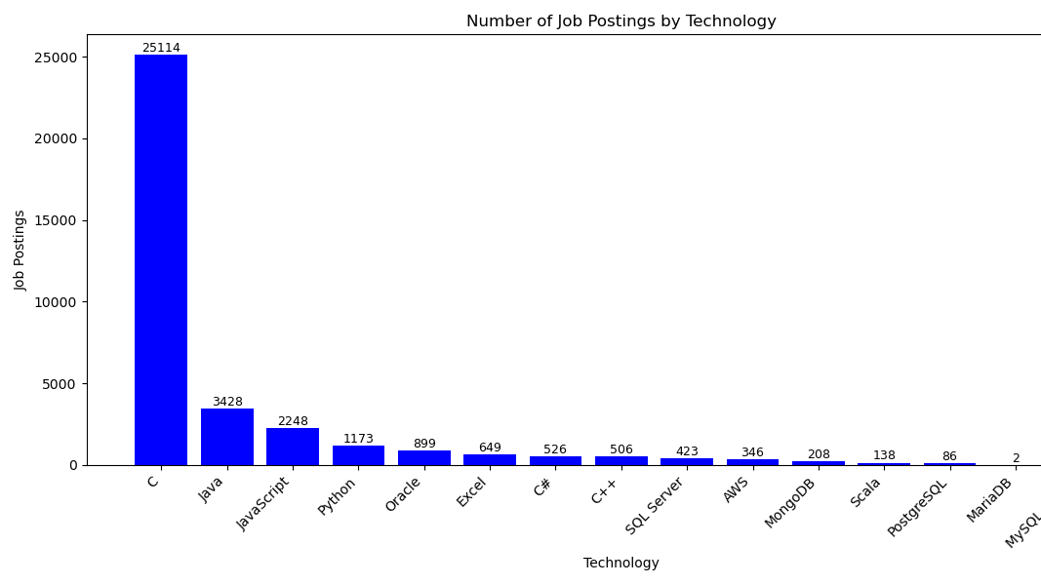
JOB POSTINGS

Slide 22
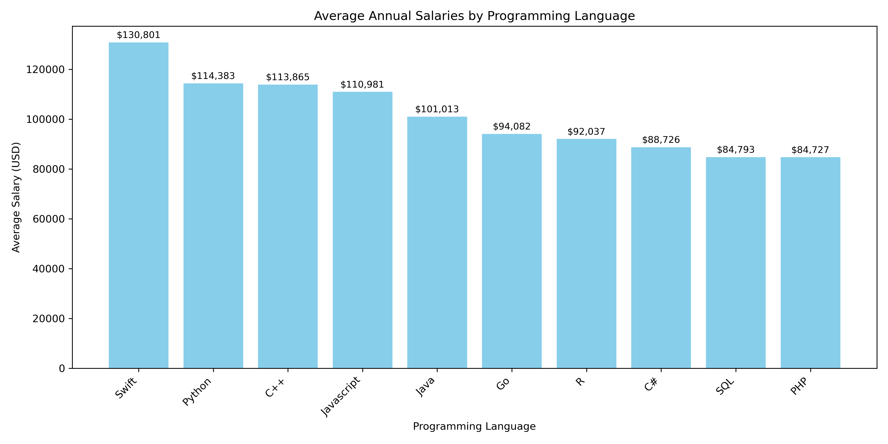
POPULAR LANGUAGES

Slide 23
Thank you

